Slide 1

Encapsulation and Inheritance
Object oriented programming

Slide 2
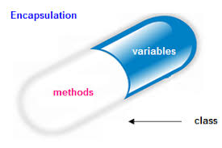
Encapsulation
Encapsulation is a way of hiding the implementation details of a class from outside access and only exposing a public interface that can be used to interact with the class.
We can declare a private variable using “#” in class.

Slide 3
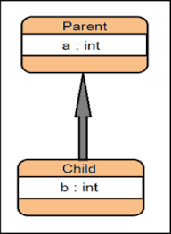
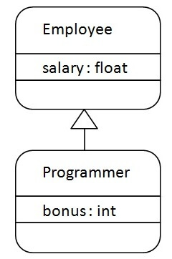
Inheritance
Inheritance is a mechanism in which one object acquires all the properties and behaviors of a parent object.

